Slide 1

Algebra Interactive Notebook
Your Name
Class 8.4
Mrs Riksman
Term 2 Semester 1
1

Slide 2
Contents
Glossary
Page
Date
Description
Word
Description
4-5
6-7
8-9
10-11
12-13
14-15
16 -17
18-19
21/4
23/4
28/4
30/4
5/5
7/5
19/5
20/5
Parts of an Equation
Writing Algebraic Expressions
Simplifying expressions
Adding and Subtracting Like Terms
Simplifying expressions -multiplication
Simplifying expressions –division
Expanding Brackets
Expanding brackets and collecting like terms
Factorising Expressions

Slide 3
Title:
Date:
Tasks
24
7
30
Essential Question
Questions
Notes
Summary
4
5

Slide 4
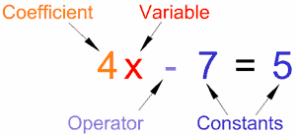
24
7
30
Title: Parts of an equation
Date: 21/4/15
EQ : Describe the difference between an expression and an equation. Label the different parts of an equation namely the constant, variable and co-efficient.
Question:
Notes:
Describe the difference between an expression and an equation.
Label a diagram of an equation using the terms coefficient, variable and constant.
An expression is a group of terms (the terms are separated by + or – signs).
An equation says that two things are equal. So that makes an equation a statement. An equation will have an equal sign “=
Parts of an Equation
Here we have an equation that says 4x-7 equals 5, and all its parts:
5
5

Slide 5
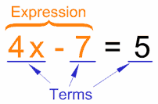
Question:
Notes:
Provide meanings for the following:
Variable
Constant
Coefficient
Operator
Term
A Variable is a symbol for a number we don't know yet. It is usually a letter like x or y. A number on its own is called a Constant. A Coefficient is a number used to multiply a variable (4x means 4 times x, so 4 is a coefficient) An Operator is a symbol (such as +, ×, etc) that represents an operation (ie you want to do something with the values).
A Term is either a single number or a variable, or numbers and variables multiplied together. An Expression is a group of terms (the terms are separated by + or - signs)
5

Slide 6
Tasks
Match the vocabulary to the correct definition. Write the answer in the left hand side of your notebook.
Algebraic Expression |  | Each part of an expression separated by an operation
Coefficient |  | A number that stands by itself
Constant |  | A number that does not stand by itself. It is attached to the variable.
Term |  | A letter that stands for a particular numerical value
Variable |  | A number sentence without an equal sign, has at least one two terms and one operation

Slide 7
Identify each part of the algebraic expression as the coefficient, constant, or variable.
1. 4x - 12
4 is a(n) ___________________
x is a(n) ___________________
12 is a(n) __________________
2. a + 3b
a is a(n) ___________________
3 is a(n) ___________________
b is a(n) __________________
3. 6y
6 is a(n) ___________________
y is a(n) ___________________

Slide 8
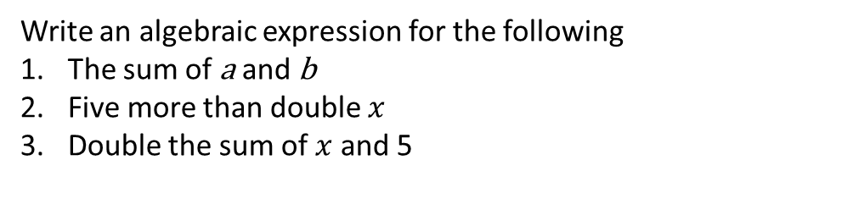
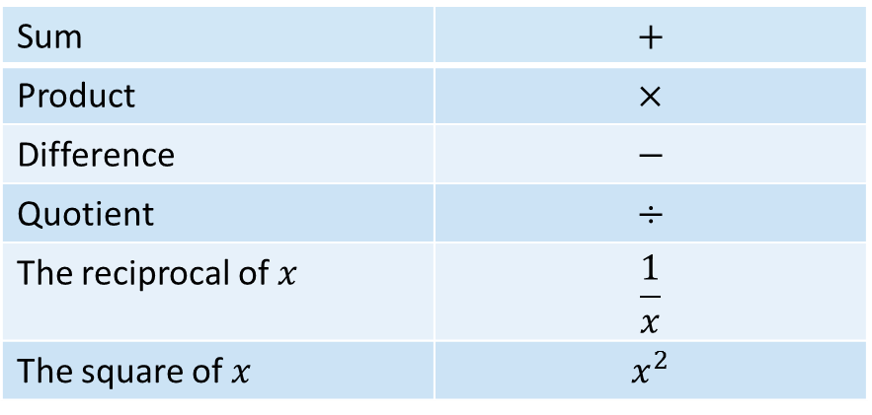
24
7
30
Title: Writing Algebraic Expressions
Date: 23/4/15
EQ : How can I use symbols to simplify problems with unknown values?
Question:
Notes:
Sum | $$+$$
Product | $$×$$
Difference | $$−$$
Quotient | $$÷$$
The reciprocal of $x$ | $$\frac{1}{x}$$
The square of $x$ | $$x^{2}$$
Write an algebraic expression for the following
The sum of a and b
Five more than double $x$
Double the sum of $x$ and 5
7

Slide 9
Task

Slide 11
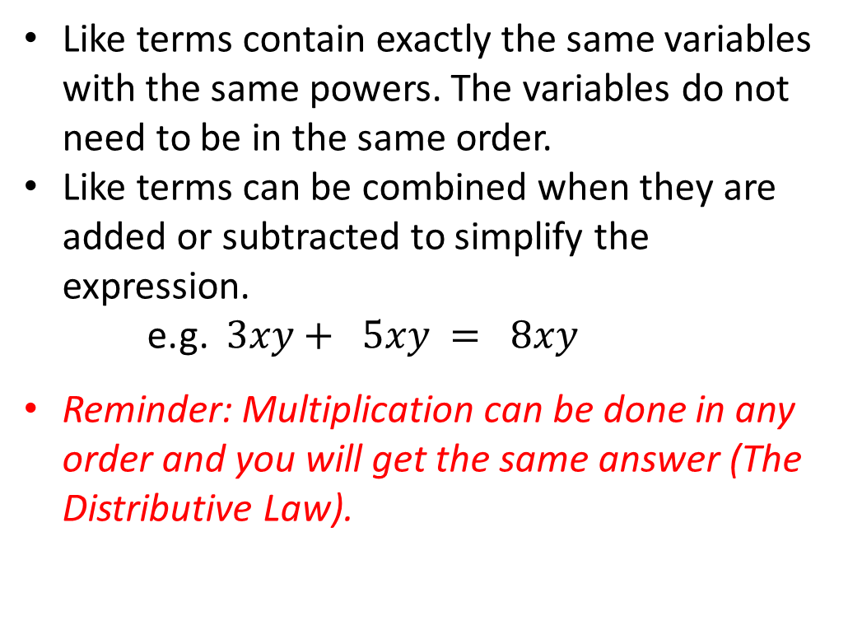
24
7
30
Title: Simplifying Expressions
Date: 28/4/15
EQ : What is a ‘like term’ and how do I collect them?
Question:
Notes:
What are like terms?
Like terms contain exactly the same variables with the same powers. The variables do not need to be in the same order.
Like terms can be combined when they are added or subtracted to simplify the expression.
e.g. $3xy+ 5xy = 8xy$
Reminder: Multiplication can be done in any order and you will get the same answer (The Distributive Law).
9

Slide 12
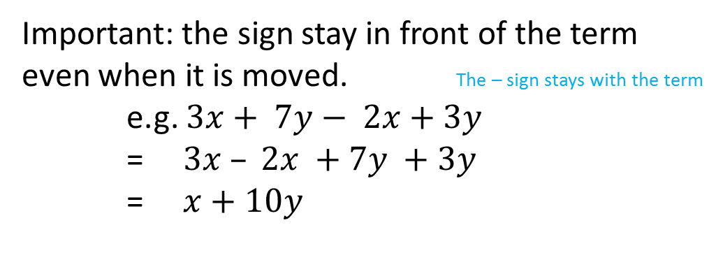
Question:
Notes:
What about the operations?
Important: the sign stay in front of the term even when it is moved. The – sign stays with the term
e.g. $3x+ 7y− 2x+3y$
= $3x – 2x +7y +3y$
= $x+10y$
9

Slide 13
Let’s try these together
$$7r+2t −3r$$
$$4x+3y+2x+7y$$
$$7ac+3b −2ca+4b −5b$$

Slide 14
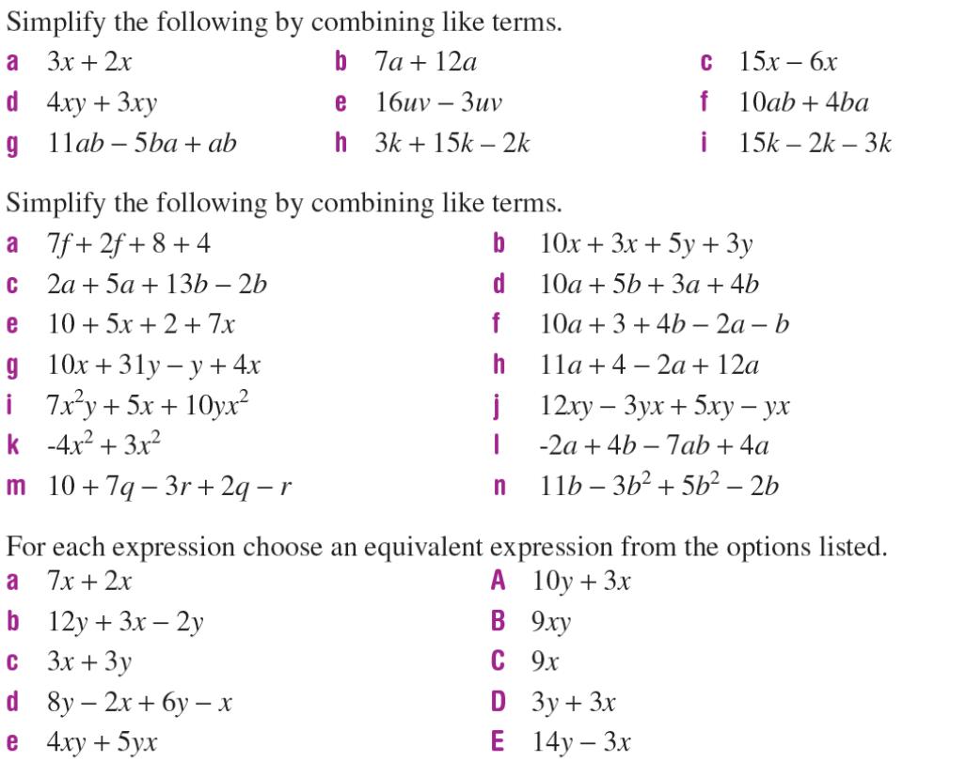
Task

Slide 15

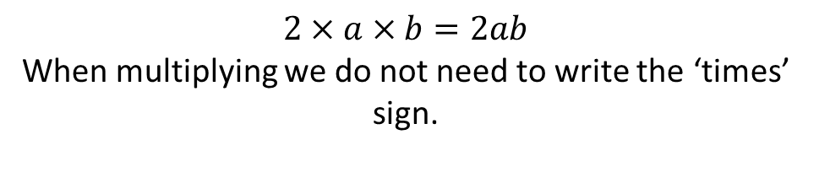

24
7
30
Title: Simplifying Expressions with Multiplication
Date: 30/4/15
EQ – How do I simplify if the terms are multiplied?
Question:
Notes:
What happens to the x sign?
$$2×a×b=2ab$$
When multiplying we do not need to write the ‘times’ sign.
Remember: The Distributive law
Examples:
Multiplication can be done in any order and the answer will be the same.
$$3xy ×4m$$
(This means $3×x×y×4×m$)
Multiply the numbers first and then put the letters together.
$$3×4×x×y×m$$
$=12xym$

Slide 16




Question:
Notes:
Something harder: $4x×3z×2xyz$
$$4×3×2×x×x×y×z×z$$
$$4x3x2=24$$
$$x×x=x^{2}$$
Only 1 $y$
$$z×z=z^{2}$$
$$=24x^{2}yz^{2}$$
11

Slide 17
Let’s try these together
$$7a×2bc×3d$$
$$3xy×5yz$$
$$−3xy×\left(−2z\right)$$

Slide 18
Task

Slide 19
Tasks
4 Simplify each of these expressions by adding like terms
2m + 5m b. 4k + 7k c. 2ab + 5ab
5mn + 2nm e. xy + xy f. 3abc + 4abc + 2bac
5 Simplify these expressions by subtracting like terms
a. 5m – 3m b. 8d – 3d c. 12mk – 7mk
45abc – 12abc e. 45fg – 13fg f. 48mn – 29mn
6 Simplify each of these by adding or subtracting like terms
5m + 2m – 3m b. 12a – 4a – 5a c. 3x + 5x + 7x
12f + 15f – 18f e. 8s² + 7s² – 6s² f. 5mn + 6mn – 4nm
3pq – 2pq + pq h. 11abc + 3abc – 5abc i. 8p – 3p – 5p

Slide 20




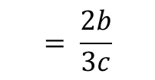



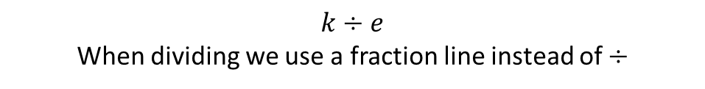
24
7
30
Title: Simplifying Expressions with division
Date: 5/5/15
EQ – How do I simplify if the terms are divided?
Question:
Notes:
$$k÷e$$
When dividing we use a fraction line instead of $÷$
What happens to the $÷$ sign?
Thus: $= \frac{k}{4}$
1
Examples:
$$÷2$$
$$÷n$$
Divide by 2
$$\frac{2kn}{4n}$$
Cancel out
$$÷2$$
$$÷n$$
2
$$= \frac{k}{2}$$
$$k means 1k$$
We don’t need to write the 1
2
$$÷5$$
$$\frac{10ab}{15ac}$$
$$÷a$$
Cancel out
Divide by 5
$$÷5$$
$$÷a$$
3
$$= \frac{2b}{3c}$$
13

Slide 21
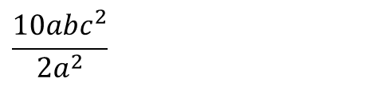
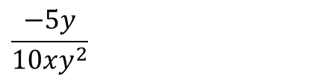
Let’s try these together
$$\frac{18x^{2}y}{8xz}$$
$$\frac{10abc^{2}}{2a^{2}}$$
$$\frac{−5y}{10xy^{2}}$$

Slide 22
Task
Enrichment:

Slide 23
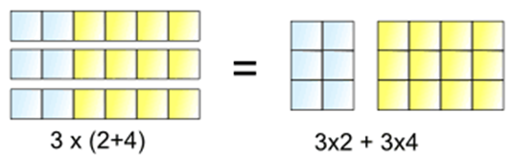
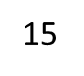
24
7
30
Title: Expanding Brackets
Date: 07/05/15
EQ – Describe how we use the distributive law to expand brackets
Question:
Describe what is meant by the “Distributive Law”
Notes:
The "Distributive Law" is written as:
a × (b + c) = a × b + a × c
It means
3 lots of (2+4) is the same as 3 lots of 2 plus 3 lots of 4

Slide 24
Question:
Notes:
The distributive law states that
a(b+c) = a x b + a x c
= ab + ac
a(b-c) = a x b - a x c
= ab - ac
Examples:
9(a + 7) = 9 x a + 9 x 7
= 9a + 63
8(m – 10) = 8 x m – 8 x 10
= 8m - 80
How do we use the distributive law to expand brackets?
15

Slide 25
24
7
30
Title: Expanding Brackets and Collecting like terms
Date: 19/05/15
EQ – Describe the two step process to expand and then collect like terms
Question:
Notes:
Using the example:
7(9f + 10) + 2f
First we need to expand the brackets as shown using the distributive law.
7(9f + 10) + 2f
= 63f + 70 + 2f
Then we need to collect the like terms in the expression.
= 65f + 70
What is the first step in expanding brackets?
How do we collect terms?
17

Slide 26
Question:
Notes:
We can also expand brackets containing more than two terms in the same way.
2(3x + 2y + 4z)
= 6x + 4y + 8z
Remember the following important steps:
We multiply the coefficient by the number outside the brackets
The operation in front of the term belongs to it
Two positive or negative integers give a positive answer
One positive and one negative integer give a negative answer
Lastly don’t forget to add or subtract like terms
What are the important steps to remember when expanding brackets?
15

Slide 27
Tasks:
8. Simplify the following by expanding and then collecting like terms
b 8(2 + 5x) + 4x c 4(2a + 8) + 7a
d 6(3v + 10) + 6v e 7(10a + 10) + 6a
f 6(3q – 5) + 2q g 6(4m – 5) + 8m
h 4(8 + 7m) – 6m I -2(3b – 2) + 7b
9. Simplify the following
b 7a(2 – 3b + 4y) c 2q(4z + 2a + 5)
d -3(2+ 4k + 2p) e -5(1 + 5q – 2r)
f -7k(r + m + s) g 4(-2a + b – 3c)
Complete Exercise 5G page 295, questions 10 - 15

Slide 28
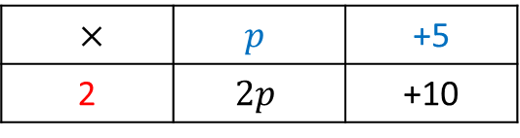
24
7
30
Title: Factorising Expressions
Date: 20/5/15
EQ – How do I use the HCF to factorise expressions?
Question:
Notes:
What is the HCF?
The highest common factor (HCF) of a set of terms is the largest factor that divides into each term.
To factorise an expression, first take the HCF of the terms outside the brackets and divide each term by it, leaving the result in brackets.
Example: Factorise 2p + 10
$×$ | $$p$$ | +5
2 | $$2p$$ | +10
Find the HCF of both terms
Divide each term by the HCF
Write the expression using brackets
2( p + 5)
19

Slide 29
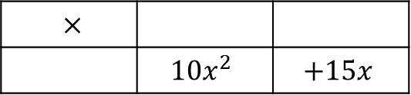
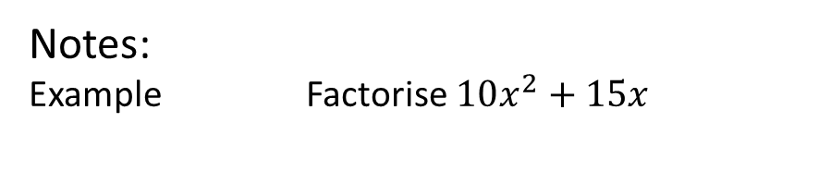
Question:
Notes:
Example Factorise $10x^{2}+15x$
$×$
 | $$10x^{2}$$ | $$+15x$$
Find the HCF of both terms
Divide each term by the HCF
Write the expression using brackets

Slide 30
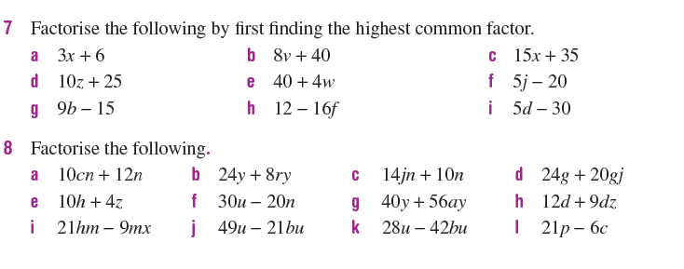
Textbook Page 300

Slide 31
Notes Review
24, 7 ,30
Date
Title
Essential question
Notes complete
Notes complete with colour and diagrams
Questions completed
Contents page filed in
Formula page filled in

Slide 32
Homework
Review your notes and write a summary answering the essential question.

